Slide 1
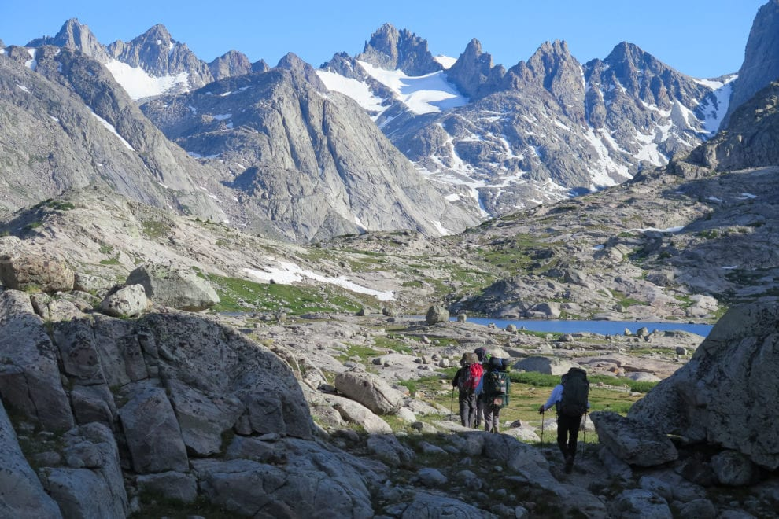
Determining Optimal Paths for Summiting
Eric Gibson
https://themountainguides.com/adventure/gannett-peak-climbs/

Slide 2
Abstract
Summiting is a popular activity for hikers, backpackers, and other outdoor enthusiasts. This study uses 10-meter spatial resolution digital elevation models and land cover raster datasets to determine optimal paths for summiters. The summits used within this study are peaks which cannot be reached via hiking trail, as those already have pre-determined paths for reaching the summit. Various optimal paths were created based on preferences of specific individuals as well. The paths provided helpful instruction for summiting peaks present within this study, however future analyses will be needed with more accurate and additional data.

Slide 3
Problem Statement
Many high points and peaks do not have a reliable path or route to the top.
Find a route to summit a peak based on preferences of the user.
These routes also provide a scientific and mathematical recommendation for the highpointer as well.

Slide 4
Input Data
Start and end points taken via the Google Places API and user input (will likely be user input). [1]
10-Meter Digital Elevation Model - collected by USGS for their 3D Elevation Program (3DEP). [2]
10-Meter Land Cover/Land Use Dataset - collected using Sentinel-2 imagery from the ESRI Land Cover Explorer. [3]

Slide 5
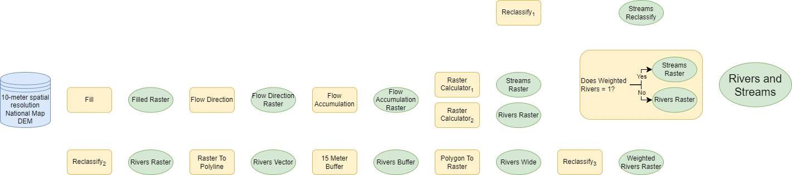
Methods: Streams and Rivers
Raster Calculator₁: Flow Accumulation > 5000
Raster Calculator₂: Flow Accumulation > 500000
Reclassify₁: If cell = 0, then change value to 1; If cell = 1, then change value to 10
Reclassify₂: If cell = 0, then change value to “NODATA”
Reclassify₃: If cell = “NODATA”, then change value to 1; If cell = 1, then change value to 50

Slide 6
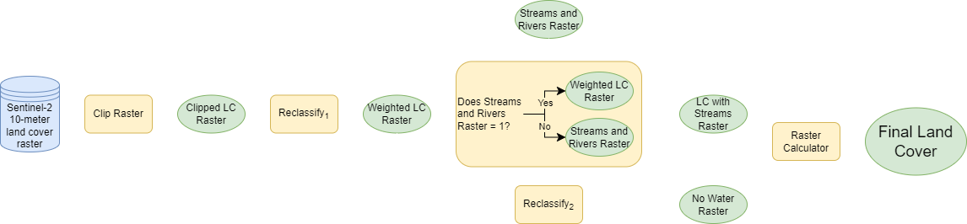
Methods: Land Cover
Reclassify₁: Keep value 2, change 4 and 5 to 3, and 9 to 8
Reclassify₂: All values changed to 1
Raster Calculator: LC with Streams Raster * No Water Raster

Slide 7
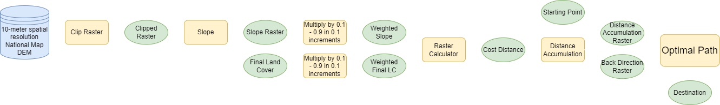
Methods: Optimal Path
Raster Calculator: Weighted Slope * Weighted Final LC

Slide 8
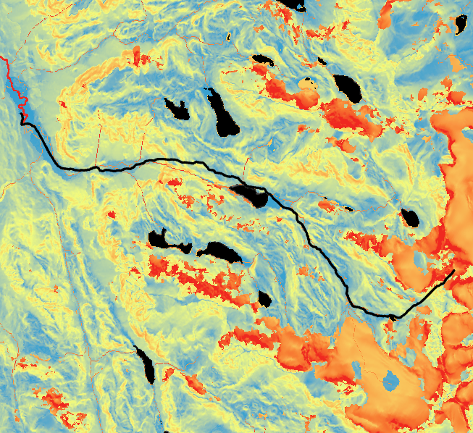
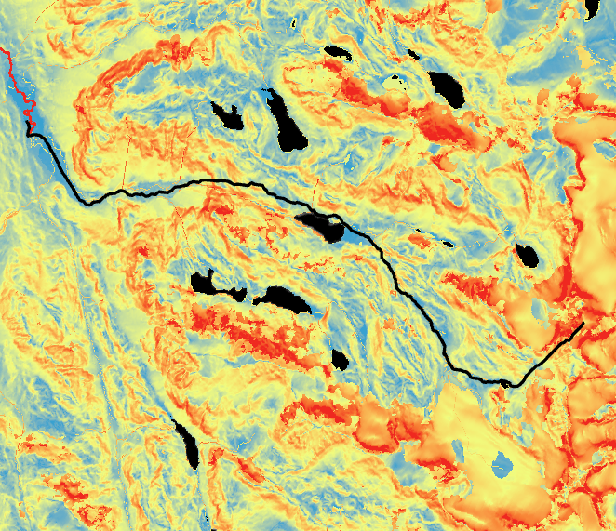
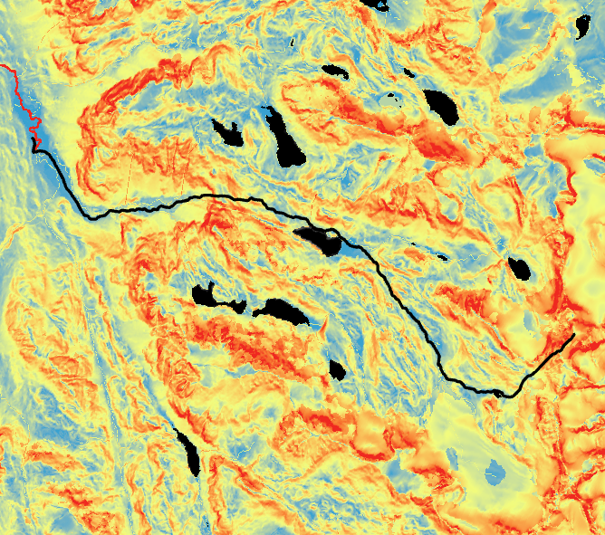
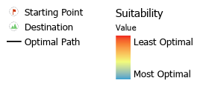
Results
Slope: 0.1 | Land Cover: 0.9
Slope: 0.2 | Land Cover: 0.8
Slope: 0.3 | Land Cover: 0.7

Slide 9
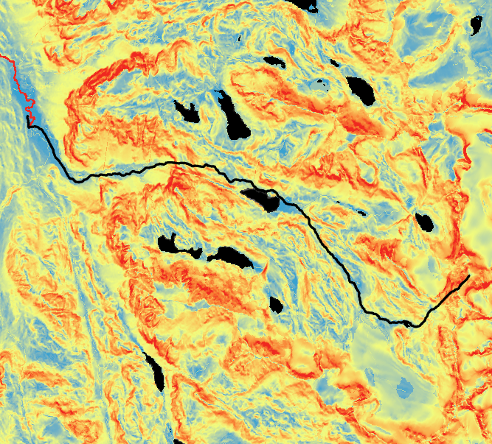
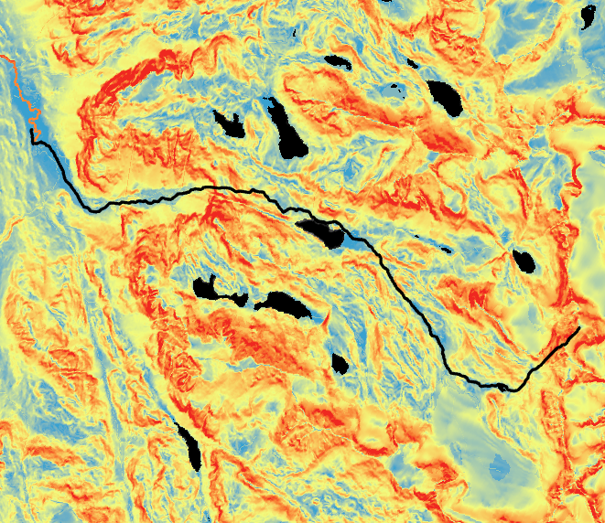
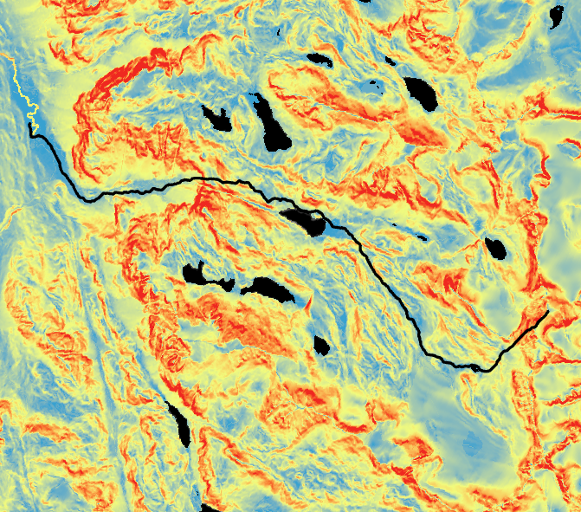
Results cont.
Slope: 0.4 | Land Cover: 0.6
Slope: 0.5 | Land Cover: 0.5
Slope: 0.6 | Land Cover: 0.4

Slide 10
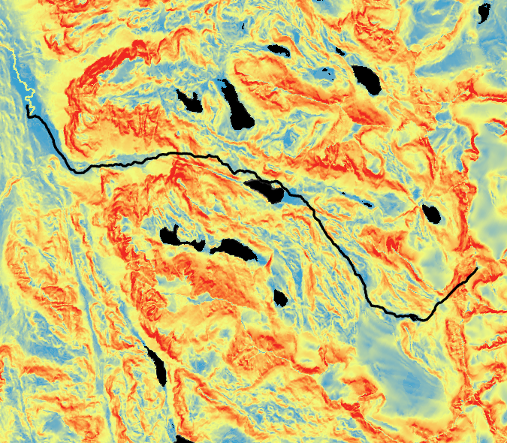
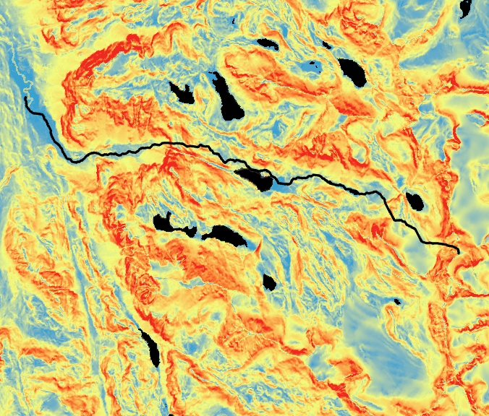
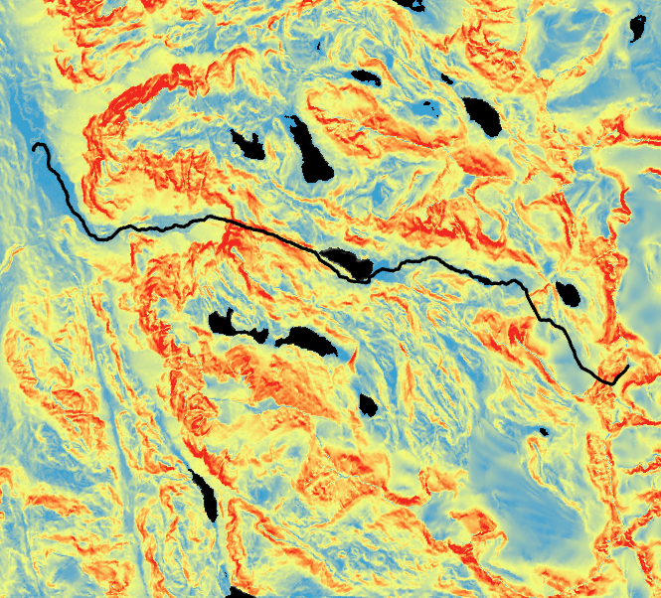
Results cont.
Slope: 0.7 | Land Cover: 0.3
Slope: 0.8 | Land Cover: 0.2
Slope: 0.9 | Land Cover: 0.1

Slide 11
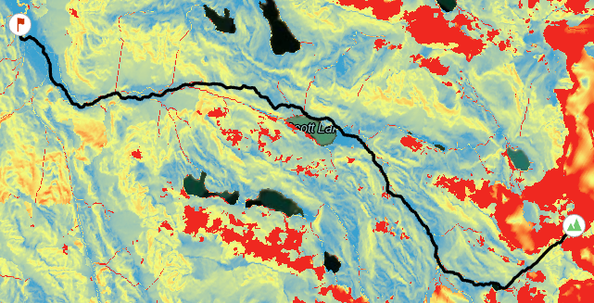
Results cont.

Slide 12
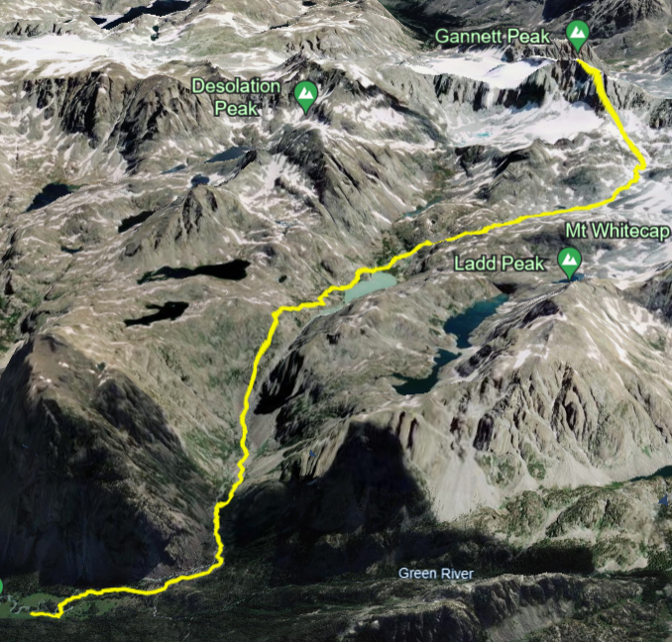
Results cont.

Slide 13
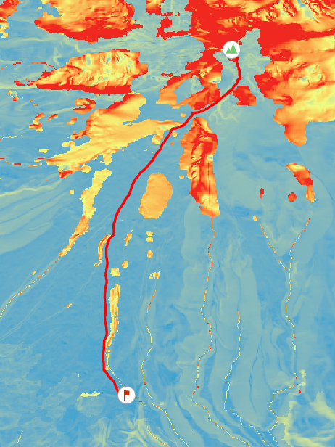
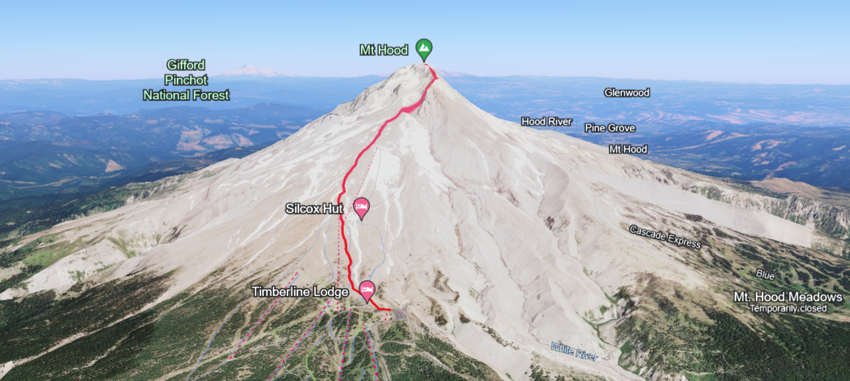
Results cont.

Slide 14
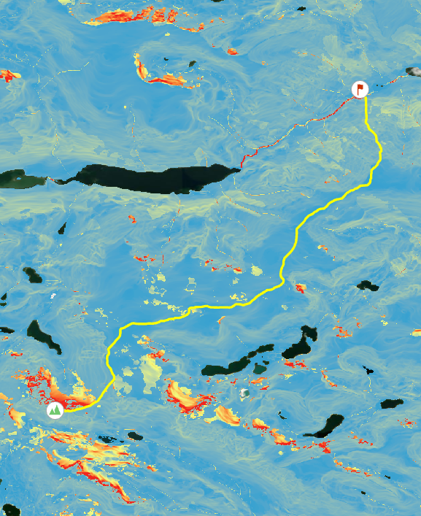
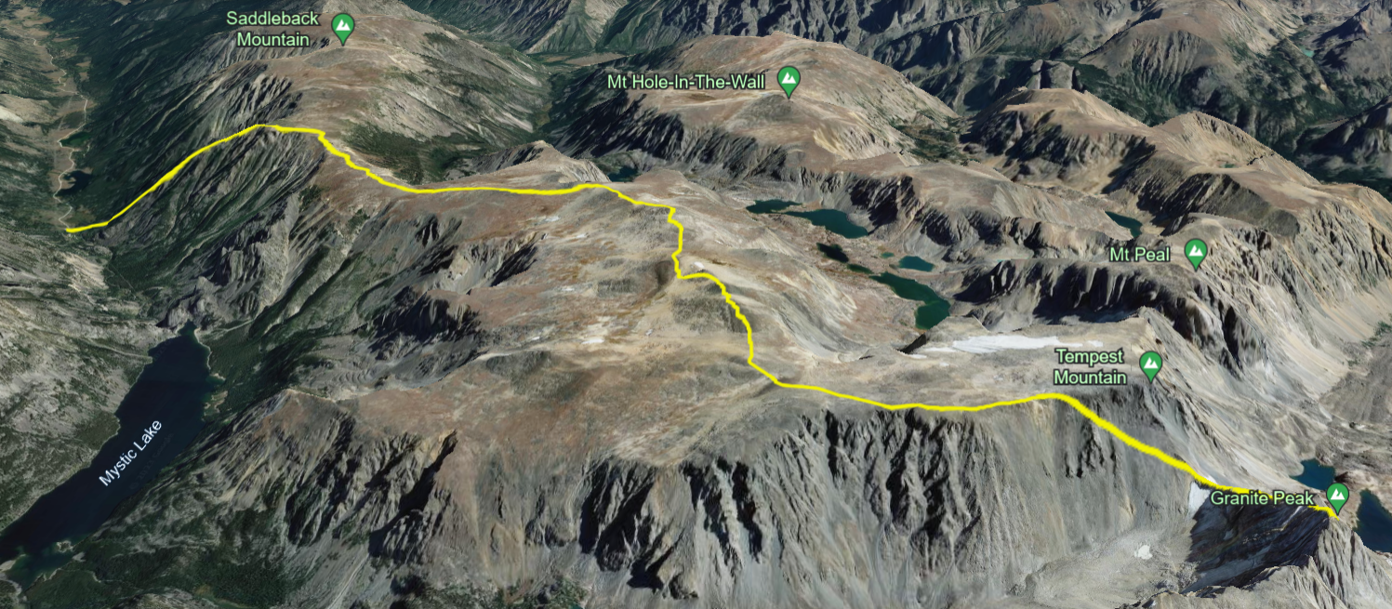
Results cont.

Slide 15
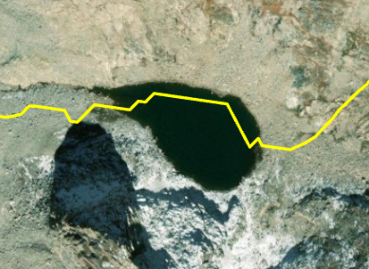
Results cont.

Slide 16
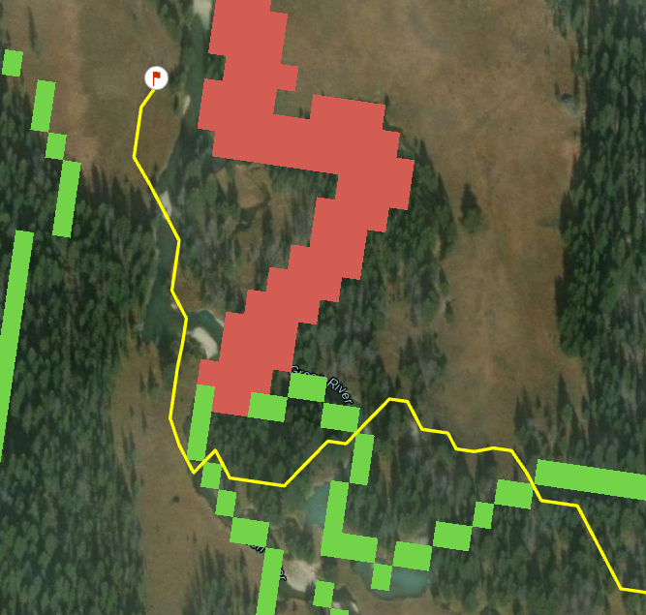
Results cont.

Slide 17
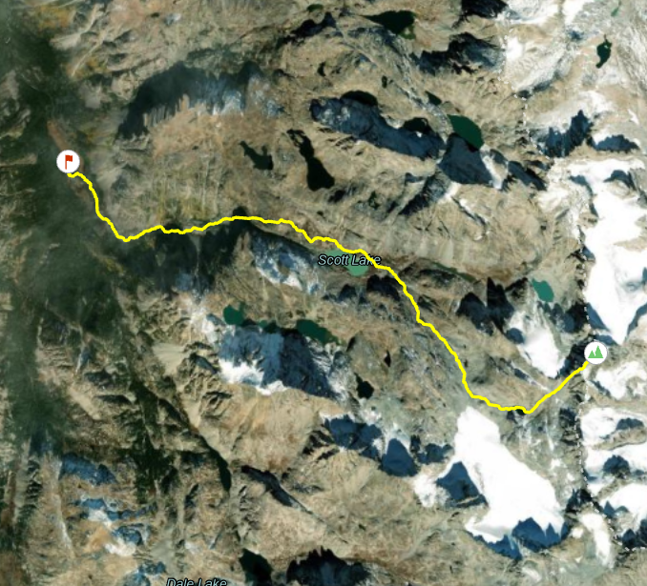
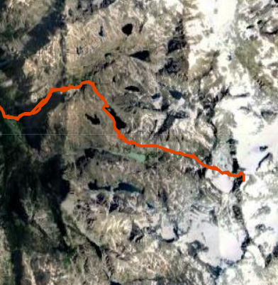
Verification
Verifications were done simply by comparing the output optimal paths determined by my model with the routes drawn and traveled by avid hikers and highpointers [4]. Quantitative verification needs to be implemented.
https://fastestknowntime.com/route/gannett-peak-wy#:~:text=and%20tough%20climbing.-,Most%20often%2C%20Gannett%20is%20approached%20from%20the%20south%20via%20the,summit%20day%20for%20most%20parties.

Slide 18
Verification cont.
Many descriptions of the best path are available online through sites like SummitPost.org. Both Mount Hood and Granite Peak had areas where the route matched and did not match. [5] [6]
Mount Hood:
Matched: Keep right of ski slopes at beginning of route
Unmatched: Stay left of Steel Cliffs and move over snow patches
Granite Peak:
Matched: End of route once the saddle between Tempest Mountain and Granite Peak is reached
Unmatched: Route along Mystic Lake - should add in trail data

Slide 19
Discussion and Conclusion
Provides helpful information for initially beginning a route for summiting.
Can reliably and successfully avoid land cover types not optimal for traversing.
The optimal paths created for differing preferences were similar except for the ones most favoring land cover.
Some manual manipulation or more accurate data may be required for future analysis
Trail data should be added along with weights based on input from professionals

Slide 20
References
[1] Chu, Justin. “Overview.” Google, developers.google.com/maps/documentation/places/web-service/overview. Accessed 09 Oct. 2023.
[2] United States Geological Survey. National Map, 1/3 Arc Second Digital Elevation Model, 2022, Accessed 6 Nov. 2022.
[3] ESRI. “Esri | Sentinel-2 Land Cover Explorer.” Sentinel-2, Land Use Land Cover, 2022, Accessed 6 Nov. 2022.
[4] Redwic. “Gannett Peak.” SummitPost.Org, www.summitpost.org/gannett-peak/150362. Accessed 13 Nov. 2023.
[5] John. “Mount Hood.” SummitPost.Org, www.summitpost.org/mount-hood/150189. Accessed 13 Nov. 2023.
[6] Lemke, Matt. “Granite Peak.” SummitPost.Org, www.summitpost.org/granite-peak/150239. Accessed 13 Nov. 2023.
ESRI. “ArcGIS pro Geoprocessing Tool Reference.” ArcGIS Pro Geoprocessing Tool Reference-ArcGIS Pro | Documentation, 2023, pro.arcgis.com/en/pro-app/latest/tool-reference/main/arcgis-pro-tool-reference.htm.

